Slide 1
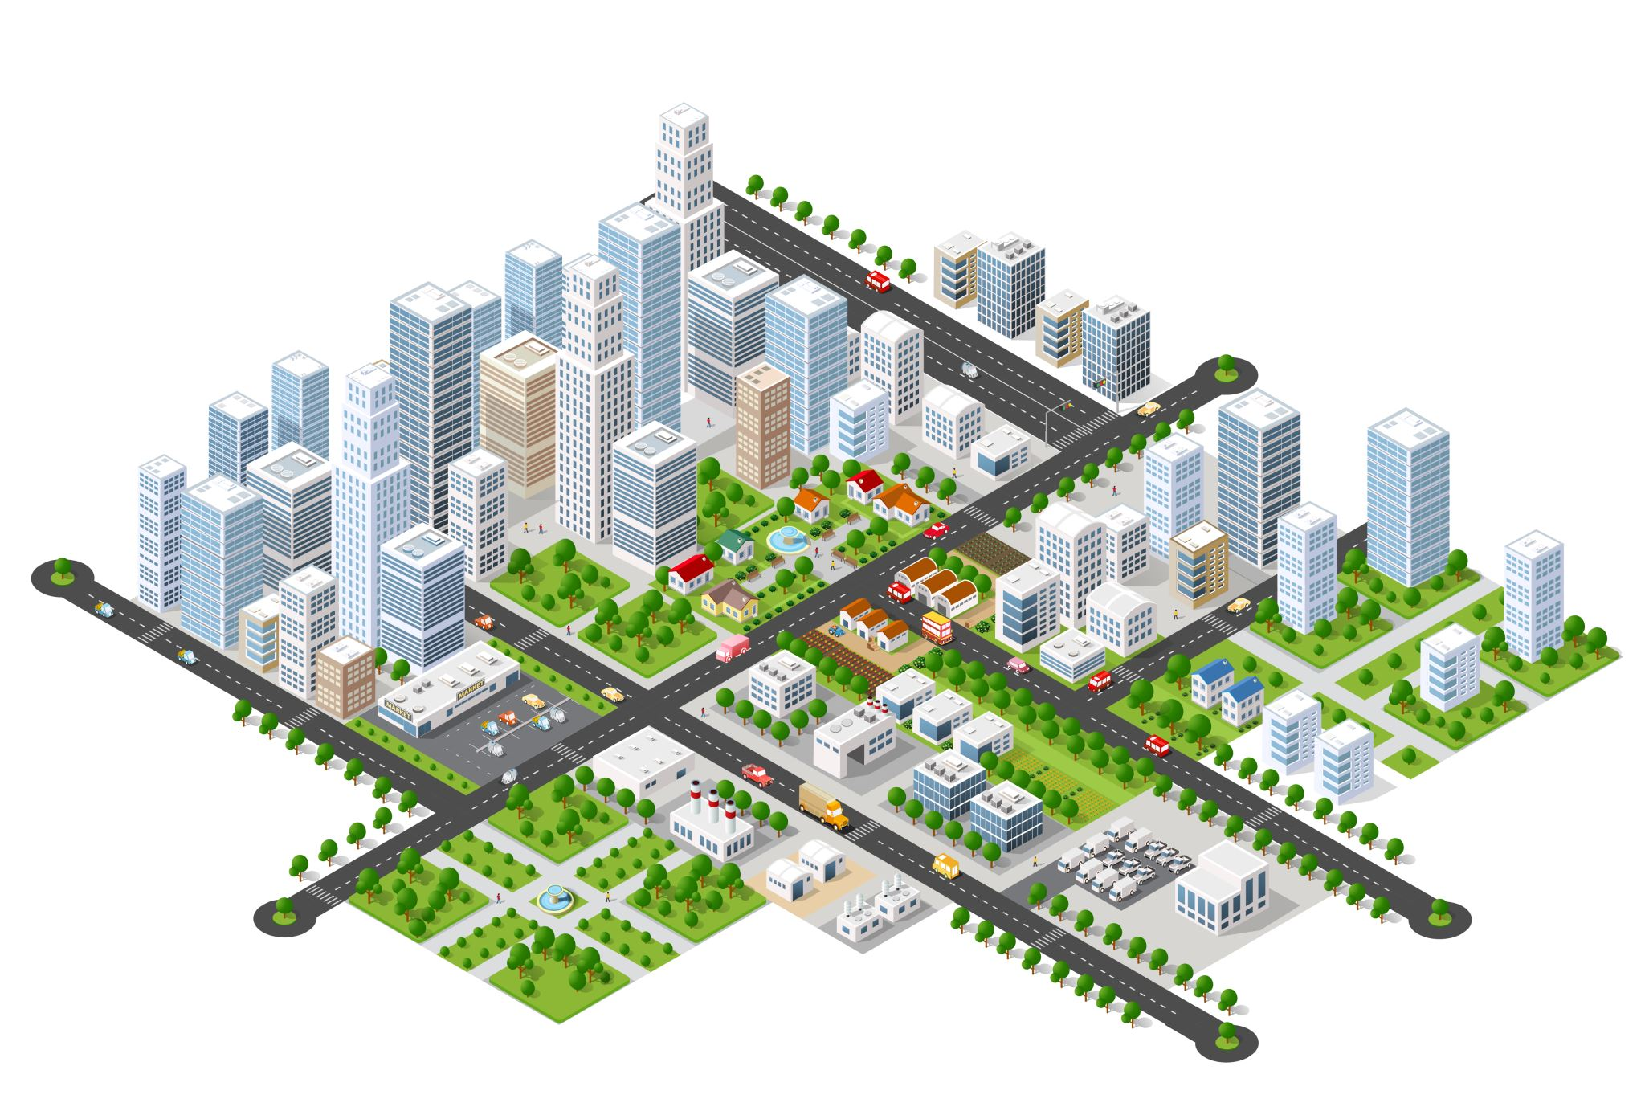


City Microclimate and Traffic Analysis
Fyrogeni Ariadne 1083816
Psychogiou Georgia 1083979

Slide 2

Microclimate
Environmental Variables
Climatic conditions measured in localized areas, restricted within 1km in the horizontal dimension and 120m in the vertical dimension, especially when these differ from the climate of the surrounding regions. The above is often caused by specific geographic, structural, or natural factors.
temperature
light
wind
humidity
frost
rain
air quality
For example, the climate may differ between:
concrete areas (Patras centre)
coastal suburbs (Marina of Patras)
forested areas and green spaces (Dasyllio)
areas with high altitude (Aroi, Patras)
A Review of Urban Microclimate Research Based on CiteSpace and VOSviewer Analysis Jiajing Li, Yang Mao, Jingyi Ouyang and Shuanning Zheng - International Journal of Environmental Research and Public Health
Notes:
Block scale localization
The significance of studying the urban microclimate lies in its ability to guide urban designers to create a more conducive public activity space by arranging site landscape elements and activity spaces. At present, people cannot control the climate on a large scale (such as global climate or regional climate), so when designing and building urban planning, it is necessary to consider how to better adapt to the above macro-climatic conditions.

Slide 3
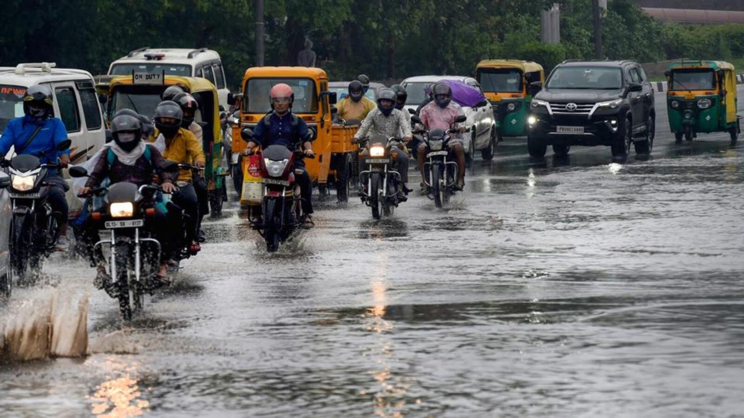
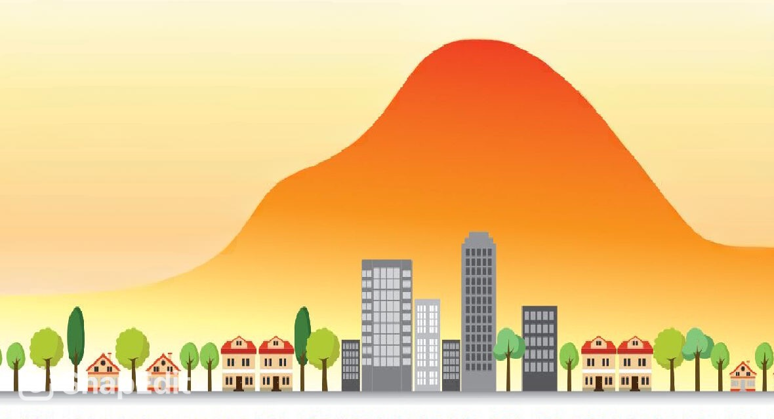
Circulation Problems
Urban Heat Island (UHI) Effect is a climatic phenomenon in which an urban area is significantly warmer than the surrounding suburban areas due to vehicular traffic and exhaust emissions, dark road surfaces that absorb more solar radiation, limited vegetation and geometric effects of high-rise buildings.
During extreme cases of heavy rainfall, some roads located near the sea or rivers is possible to flood, resulting in traffic disruption of one or more lanes. Drivers must bypass the obstruction, causing circulation delays in junctions and traffic lights.
Microclimate investigation of vehicular traffic on the urban heat island through IoT-Based device Emir Husni, Galang Adira Prayoga, Josua Dion Tamba, Yulia Retnowati, Fachri Imam Fauzandi, Rahadian Yusuf, Bernardo Nugroho Yahya journal homepage: www.cell.com/heliyon
Analyzing the Effects of Rainfall on Urban Traffic-Congestion Bottlenecks Yao Yao , Daiqiang Wu, Ye Hong , Dongsheng Chen, Zhaotang Liang, Qingfeng Guan, Xun Liang, and Liangyang Dai

Slide 4
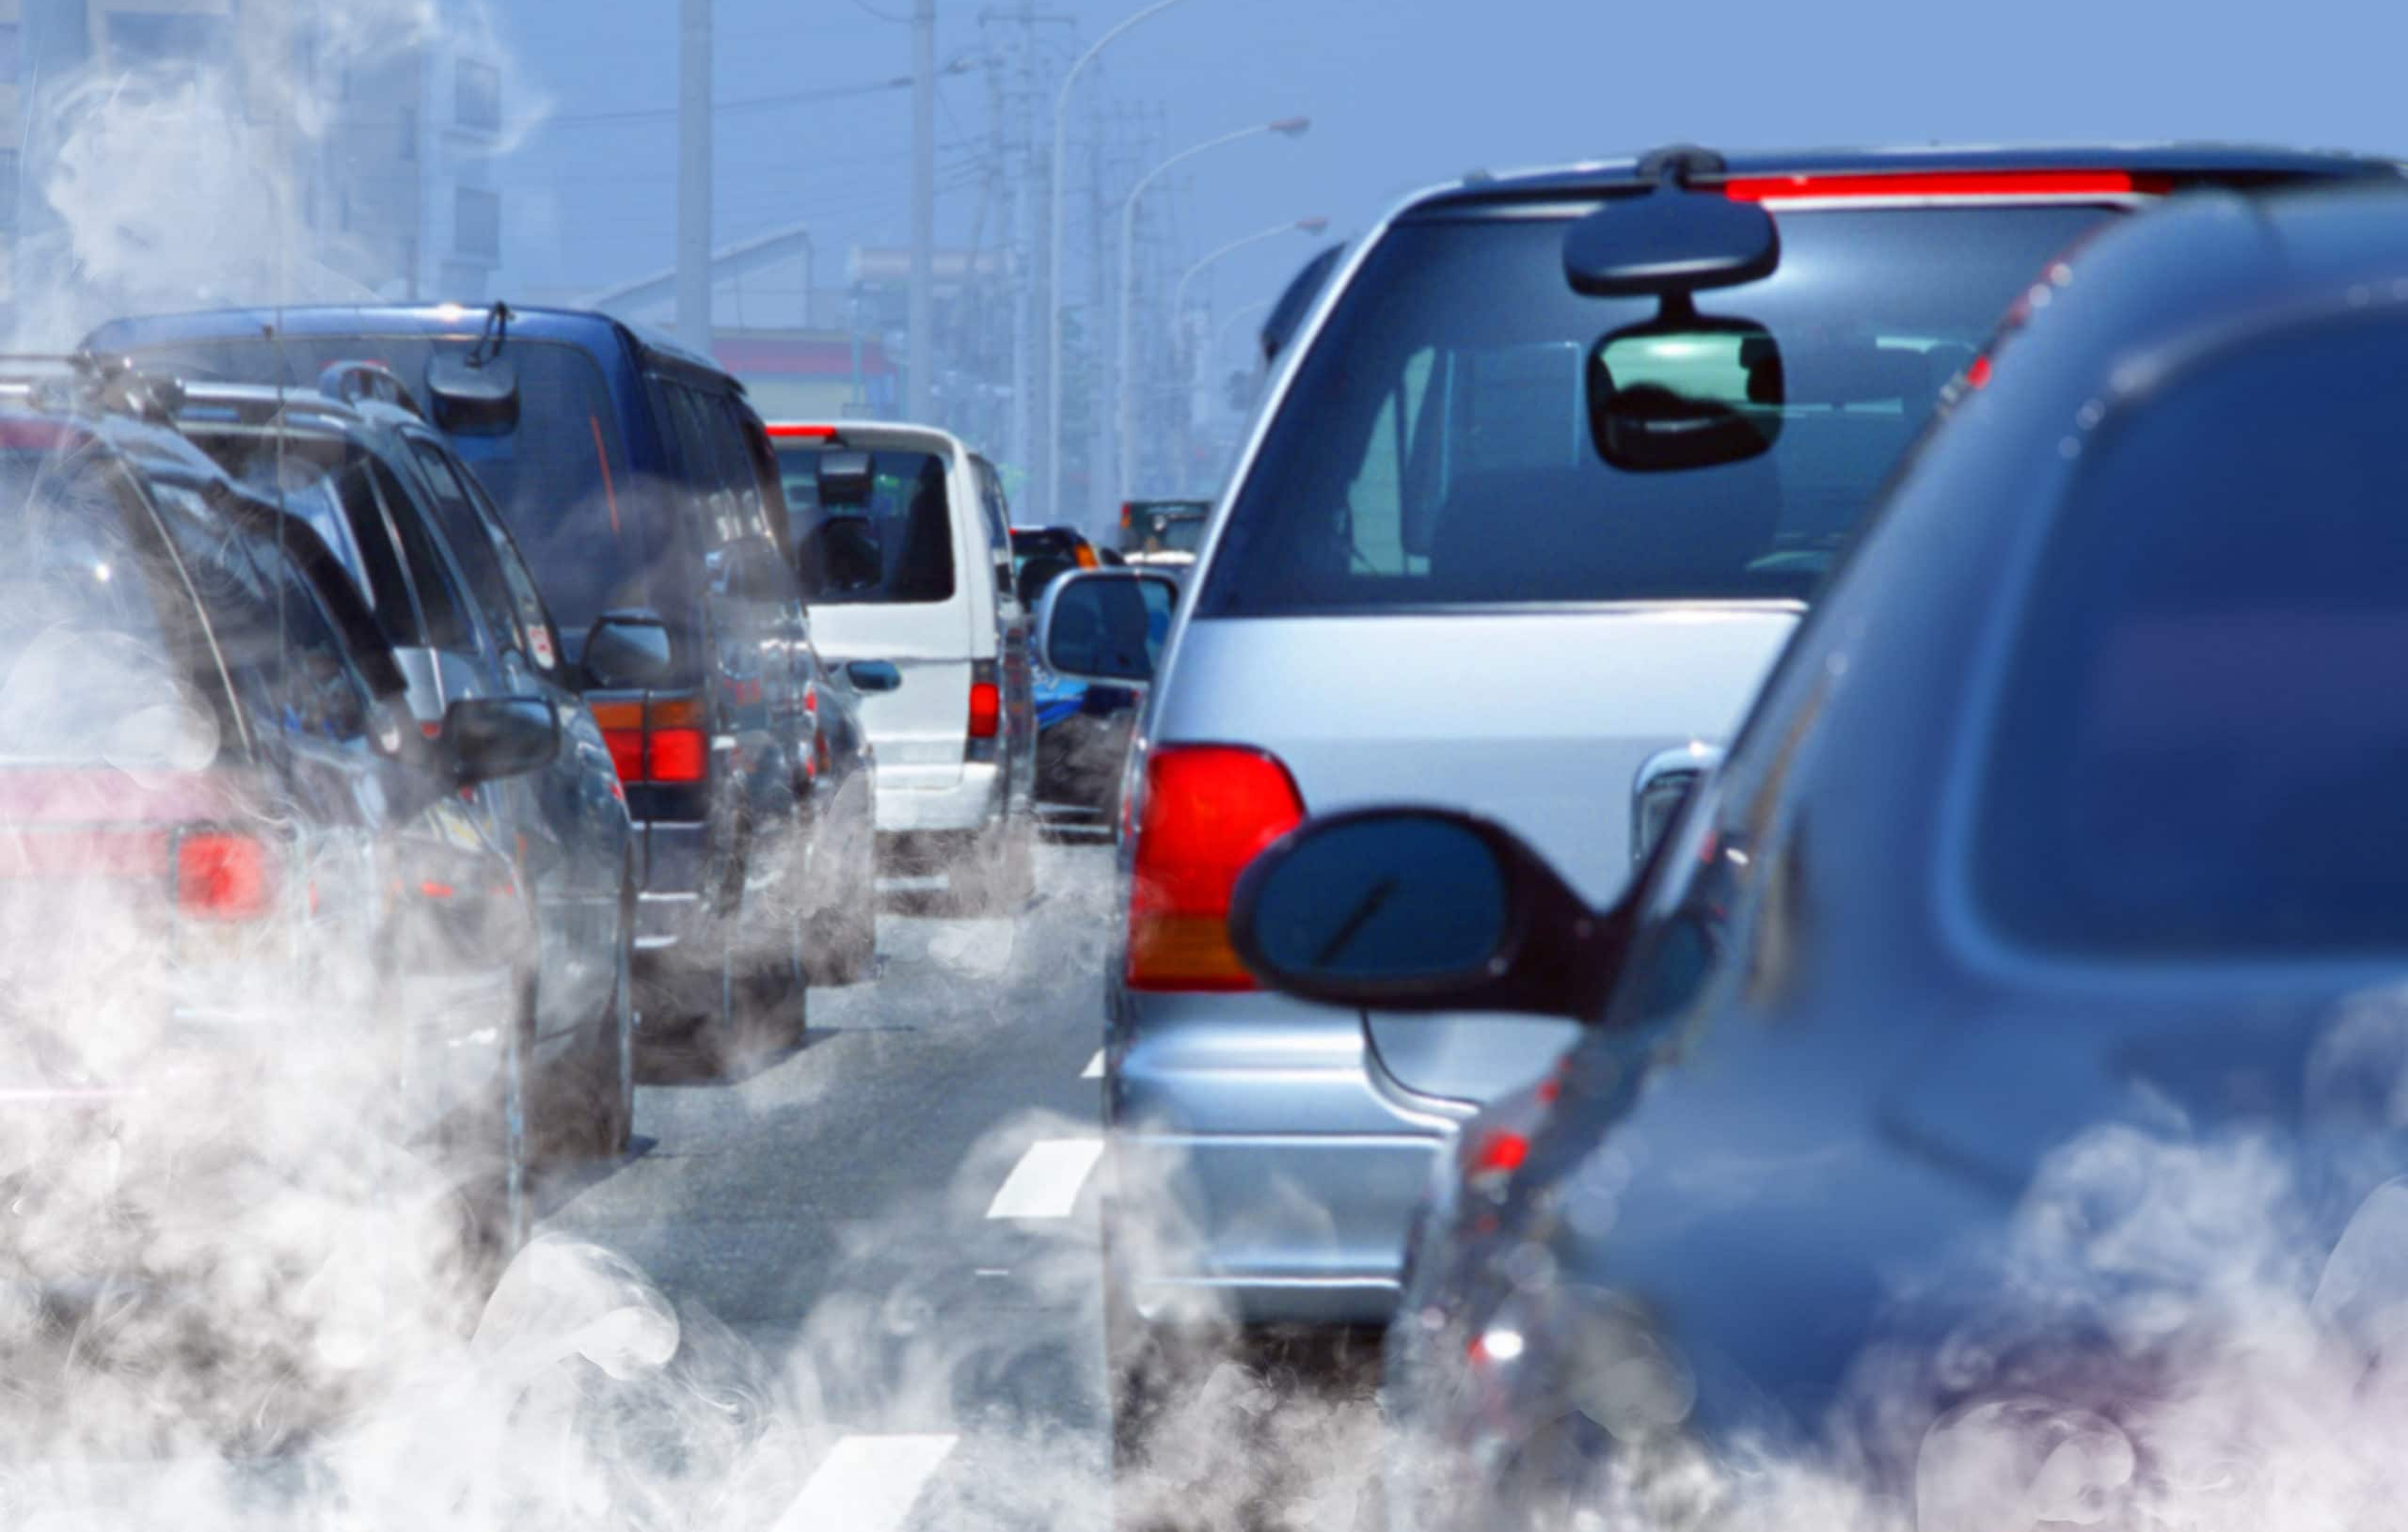
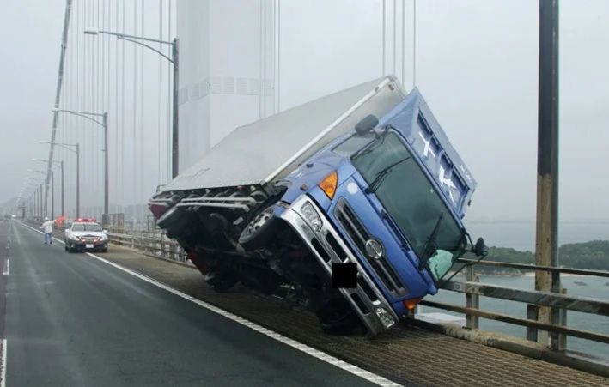
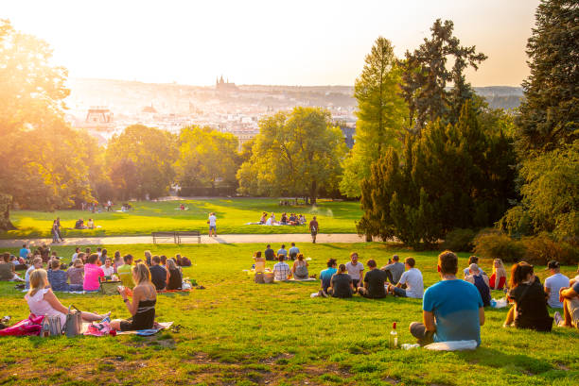
Vehicles especially those with a higher center of gravity (such as trucks), micromobility vehicles and pedestrians are more likely to be carried off, when there are strong crosswinds over a bridge or open coastal areas.
The circulation of numerous cars and motorbikes in urban areas leads to vehicle emissions, a fact that results in poor air quality and low visibility.
Effects of Wind Barriers on Wind Fields and Vehicle Stability on Bridges Xiaobo Lin, Bin Lin, Dandan Xia, Li Lin and Zhiqun Yuan
Congestion of visitors in places of interest like parks or beaches during sunny days, leading to traffic congestion in the surrounding areas.

Slide 5
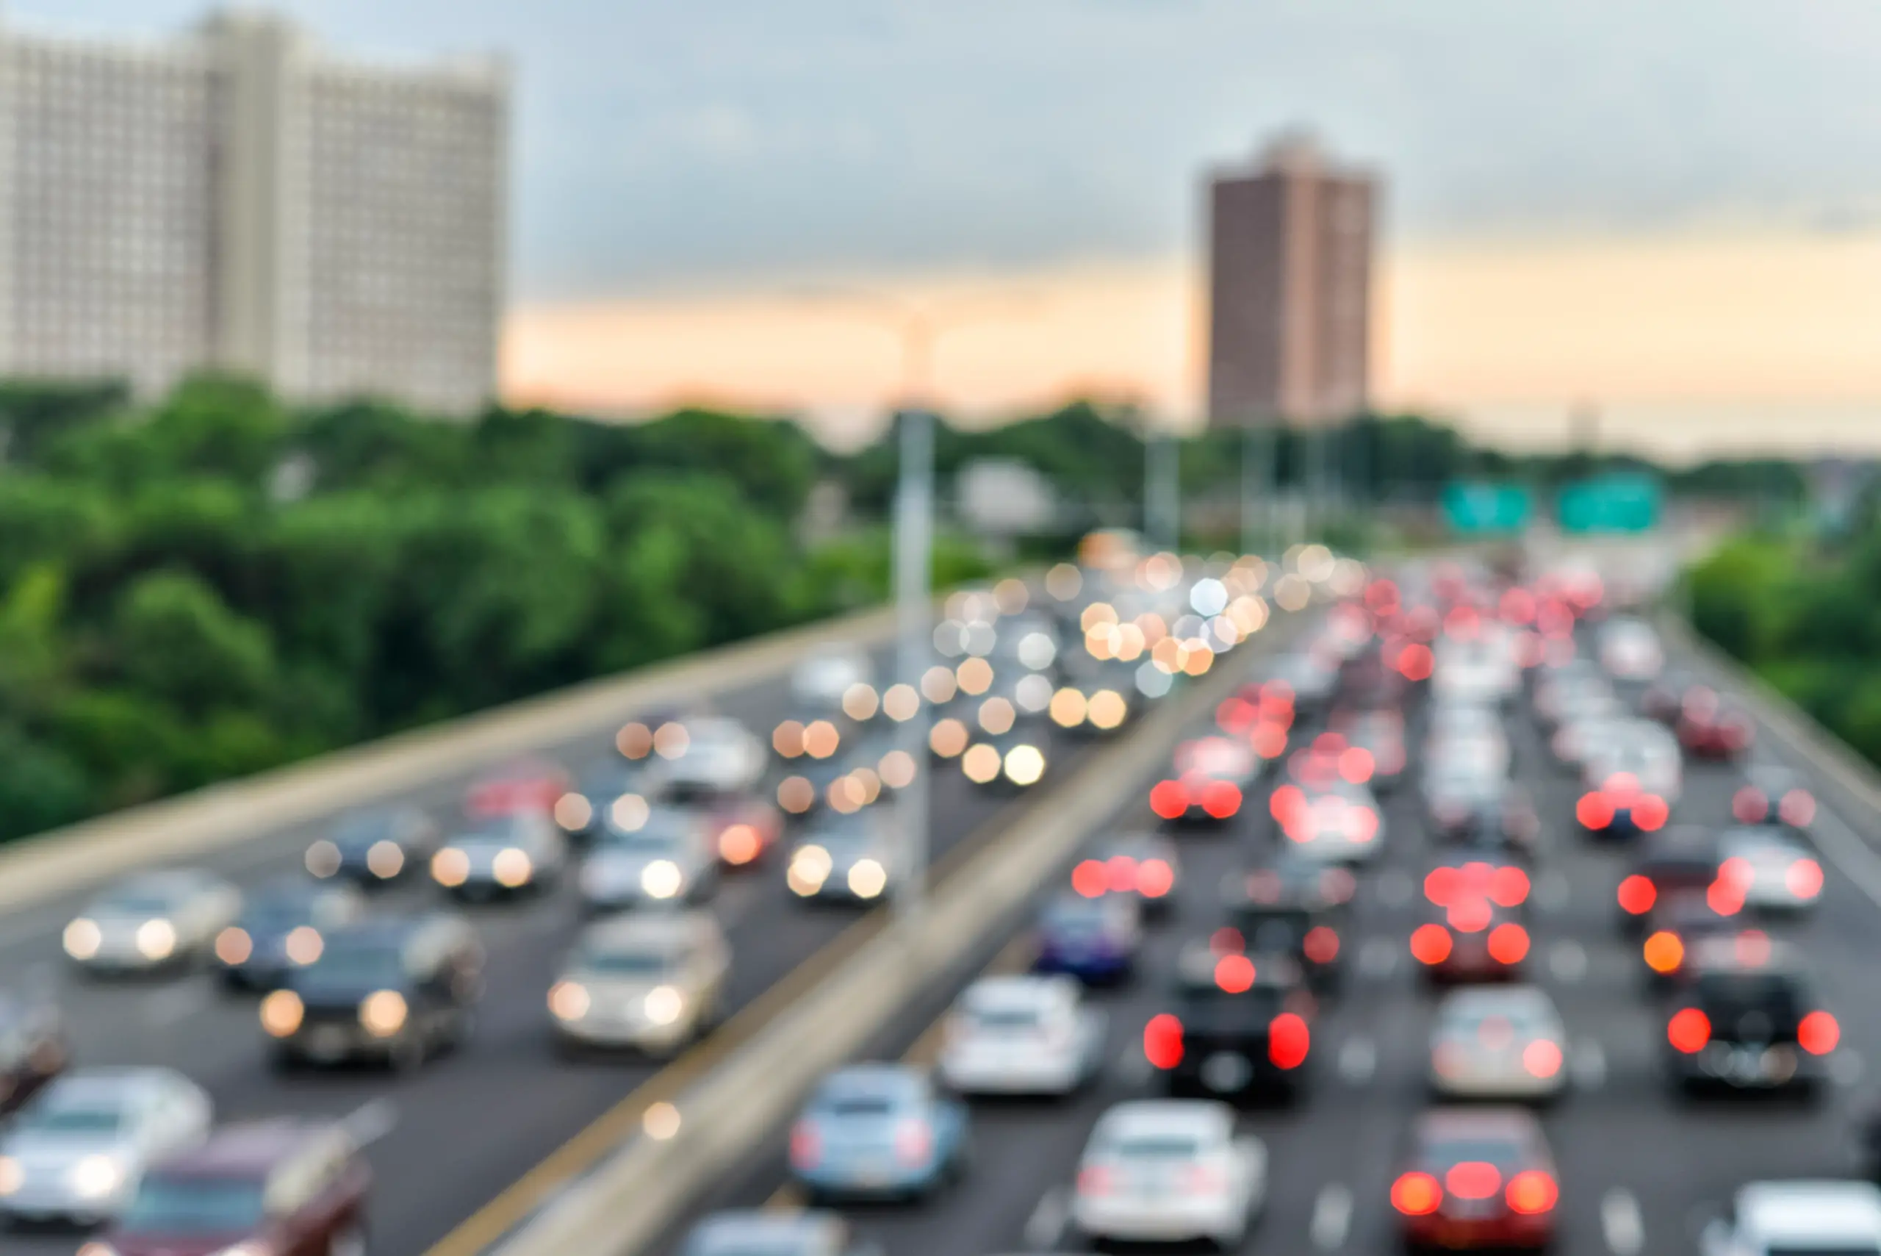
Solution
Accurate microclimate forecast and report
Estimation of traffic delays and waiting times in congestion points
Alerts notifying for traffic complications and severe weather phenomena

Slide 6




OUR IDEA Study of the correlation between weather conditions and traffic situation in specific areas.
Our idea
Aspects of traffic circulation
cars | bicycles | electric scooters | pedestrians

Slide 7
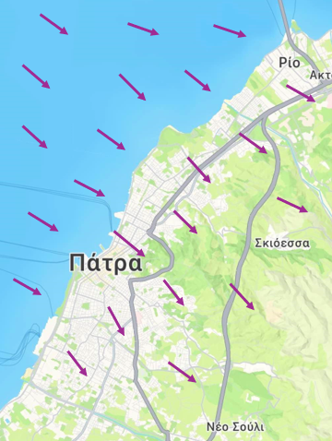
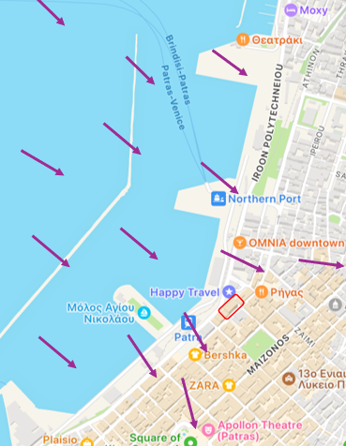
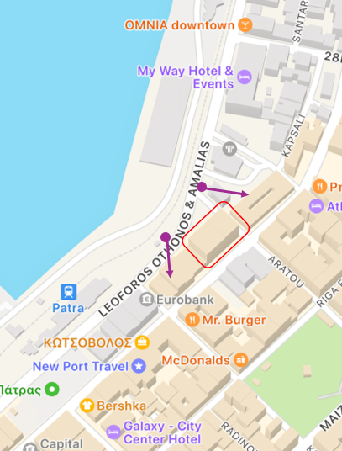
Localization of weather conditions
CORRECTION
Systematic differences are stored and modify local data
3rd party APIs
Regional weather data
Regional weather with microclimate accurate corrections
Local weather stations and sensors
Microclimate data

Slide 8
Data sources
Google maps
Google places
Weather APIs (OpenWeather, Copernicus)
Lab provided sensors
Microclimate – Traffic Correlation
Notes:
As regulated by the standards of the World Meteorological Organization (WMO), automatic weather stations are required to be situated in areas away from urbanized areas with a high volume of traﬃc and human activities. As a result, the urbanization eﬀect might have been underestimated in some of the urban microclimate studies.

Slide 9
Sensors
Air temperature (BARANI, MeteoHelix IoT Pro)
Humidity (BARANI, MeteoHelix IoT Pro)
Sun intensity (BARANI, MeteoHelix IoT Pro)
Rain amount – flood (BARANI, MeteoRain 200 Compact - MClimate, Flood sensor)
Wind speed and direction (BARANI, MeteoWind IoT Pro)
CO2 (MClimate, CO2 Sensor & Notifier)
Sound level (Dutch Sensor Systems, Ranos dB 2)

Slide 10

Target group
Data for statistic analysis
Data used to alert citizens for problems in extreme weather conditions (floods)
European Union
(TRAN)
Ministry of Infrastructure and Transportation
Infrastructure planning
Ministry of Climate Crisis and Civil Protection
Notifications for traffic issues to modify their route
Municipal Authorities
Urban planning (design streets that mitigate urban heat islands, optimize building configurations and increase green spaces)
Public transport companies
Citizens
Traffic status update
Notes:
Committee on Transport and Tourism (επιτροπή)
Υπουργείο κλιματικής κρίσης και προστασίας του πολίτη
Υπουργείο υποδομών και μεταφορών
Ministry of Infrastructure and Transportation: repair of the points of the roads ? in which traffic-related problems are reported

Slide 11


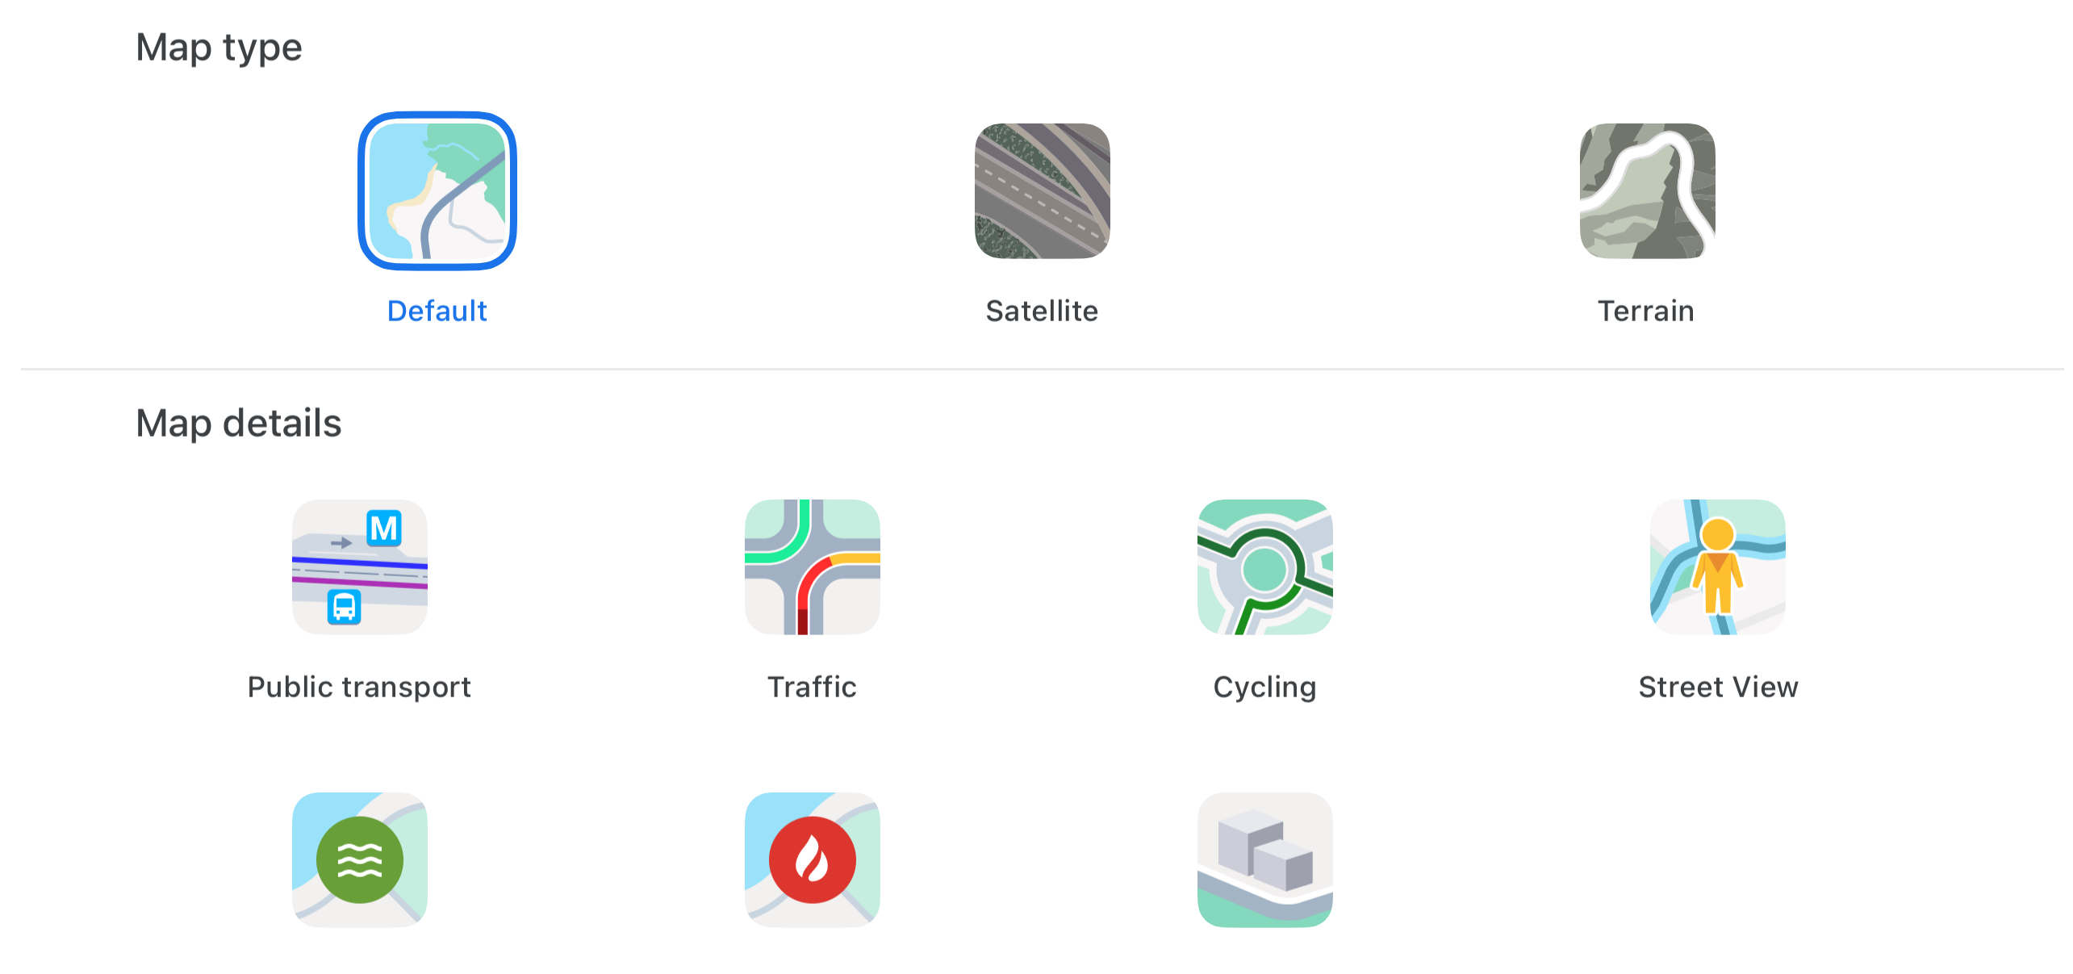
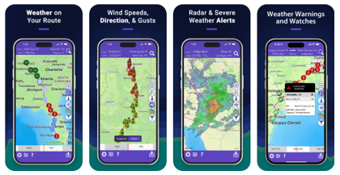
Google Maps is an app that provides real-time traffic con-ditions, delays and alternative route suggestions. However, route planning and the ability
Drive weather app is designed to show road conditions by analyzing forecasted weather and send users severe weather alerts. It enables you to see
to adjust departure times based on micro-climates is unavailable and weather insights are indirect and not detailed. A recent update, also offers safety alerts about weather-related hazards (such as floods).
how conditions like rain, snow, or storms may impact different parts of your route. This app also includes options for adjusting departure times to avoid weather-related delays.

Slide 12

Differentiating factor
Focus precisely on areas presenting traffic problems in a city
Traffic analysis not based on navigation routes for drivers but on city’s needs (historical analysis, correlation insights)
Constantly updated real data
Traffic-related problems prevention

Slide 13
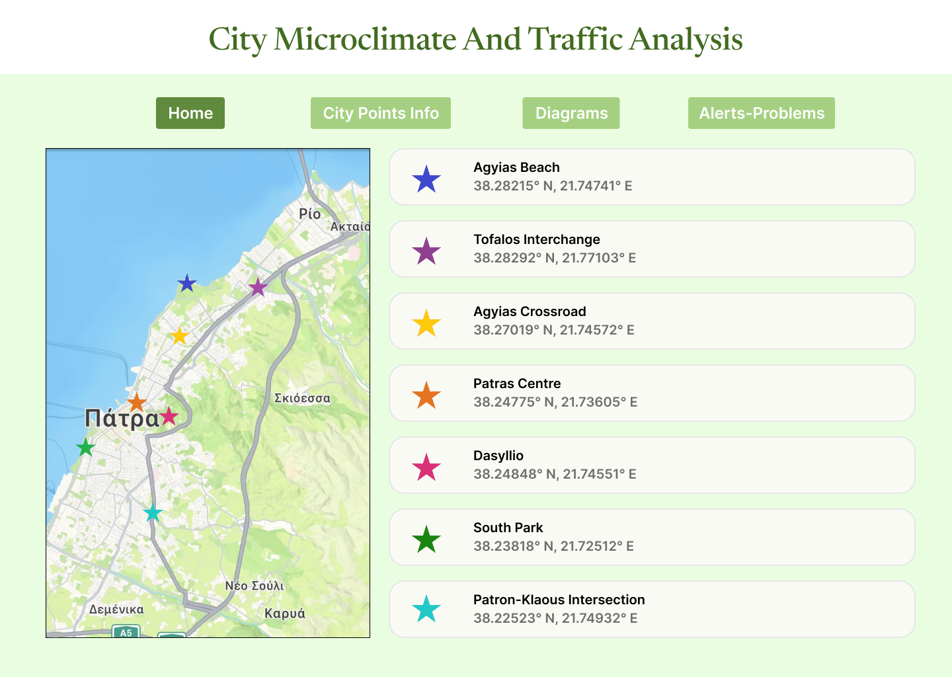

W
E
B
S
I
T
E
D
R
A
FT
Notes:
Urban Heat Island Effect

Slide 14
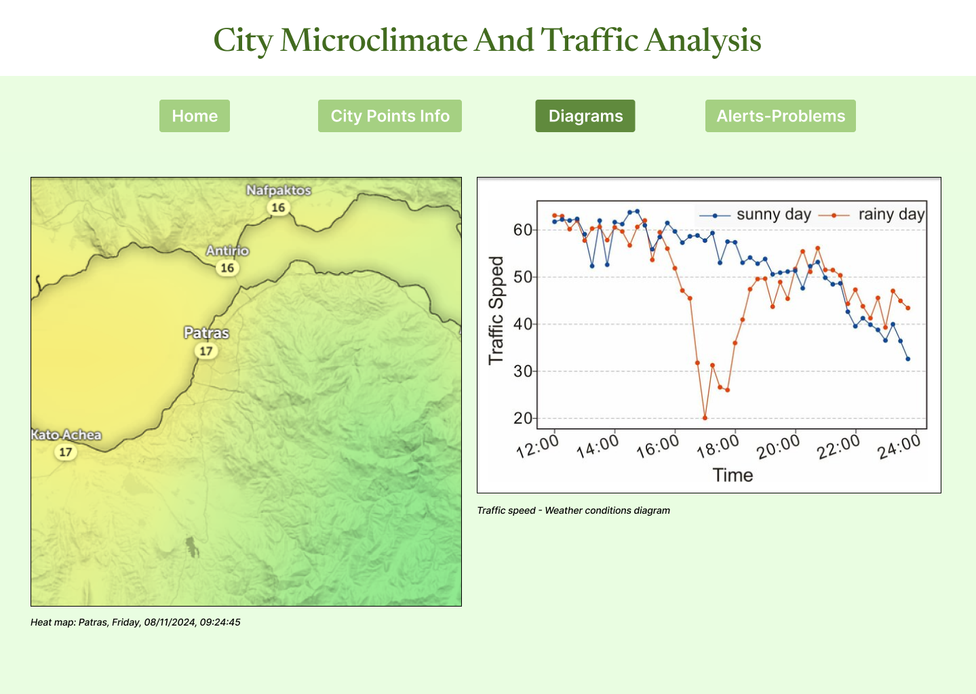
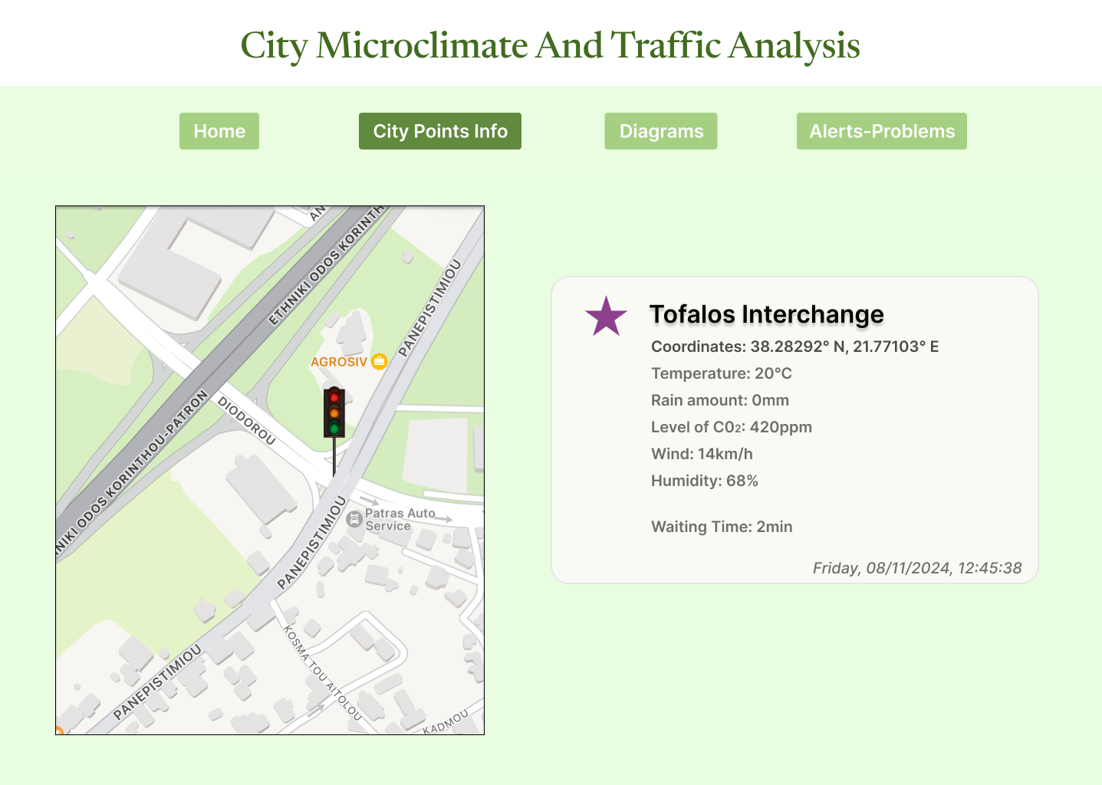

Slide 15
THANK YOU!
Any questions?

